Slide 1
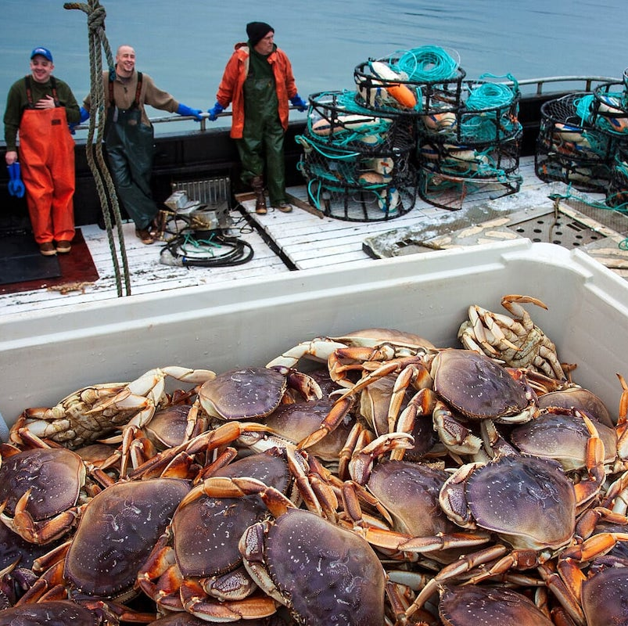
Predicting domoic acid depuration timelines in the US West Coast Dungeness crab fishery
Christopher Free, Stephanie Moore, Dan Holland

Slide 2
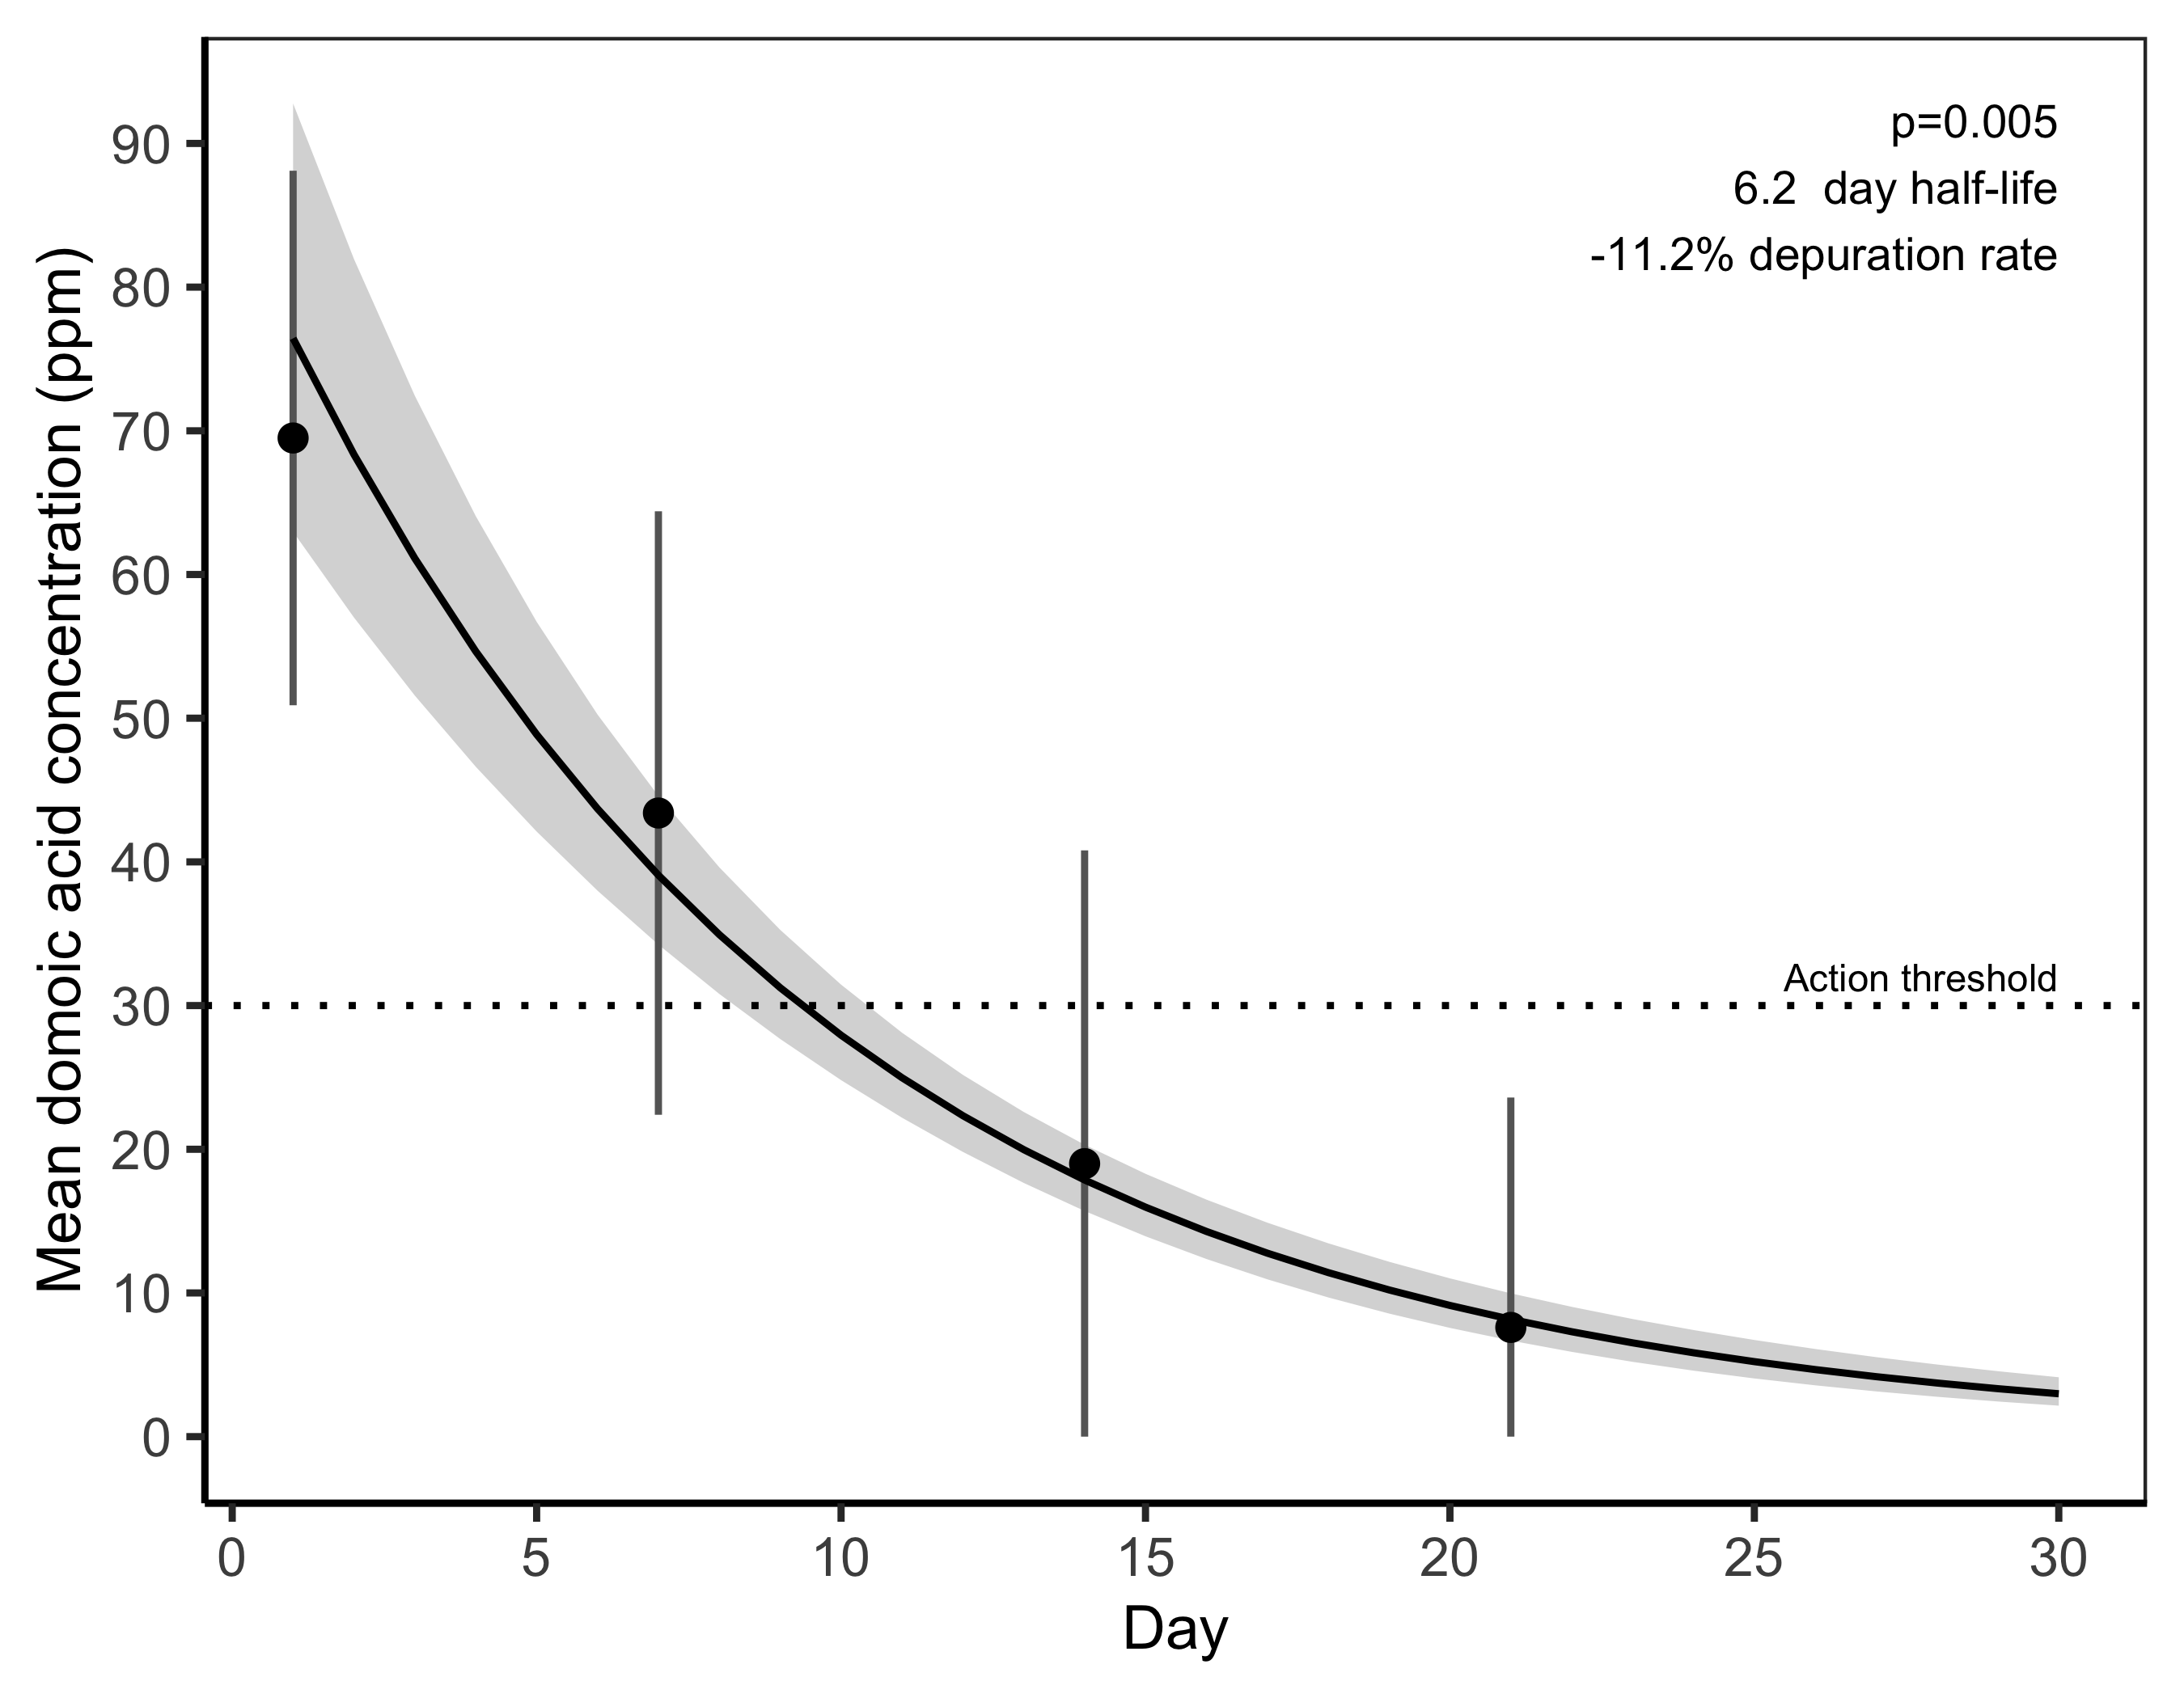
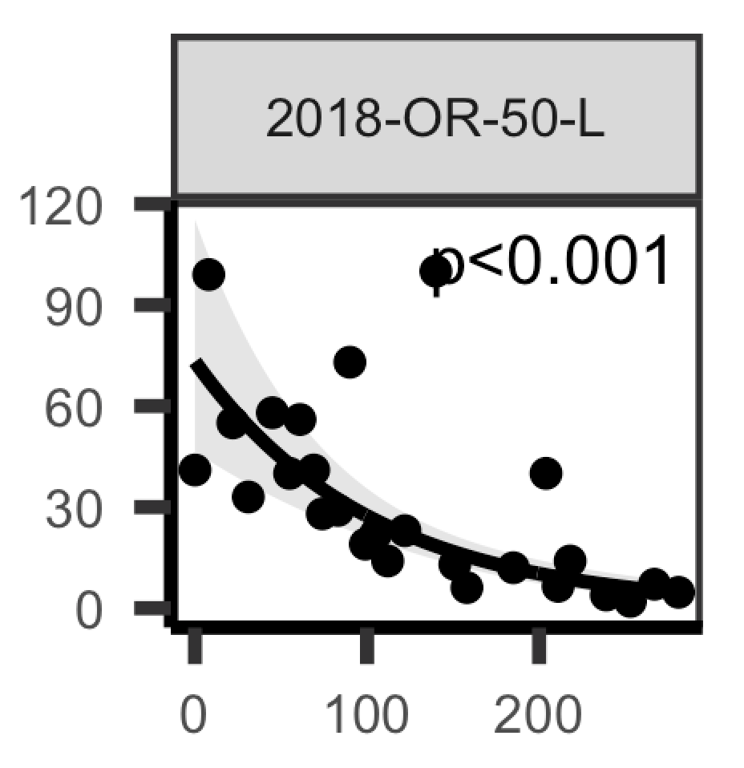
Depuration rate and timelines
“The depuration rate is the rate at which an organism loses toxicity”
Lab studies (Lund et al. 1997)
In situ studies (present work)
Maximum domoic acid
concentration (ppm)
Day

Slide 3
Value of predicting depuration timelines
Enables adaptive monitoring: slow monitoring in places with long timelines and accelerate monitoring in places with short timelines
Informs management choices: season delays when timelines are short or evisceration orders when timelines are long
Empowers adaptive business decisions: allows fishers and processors to make decisions based on expected opening date

Slide 4
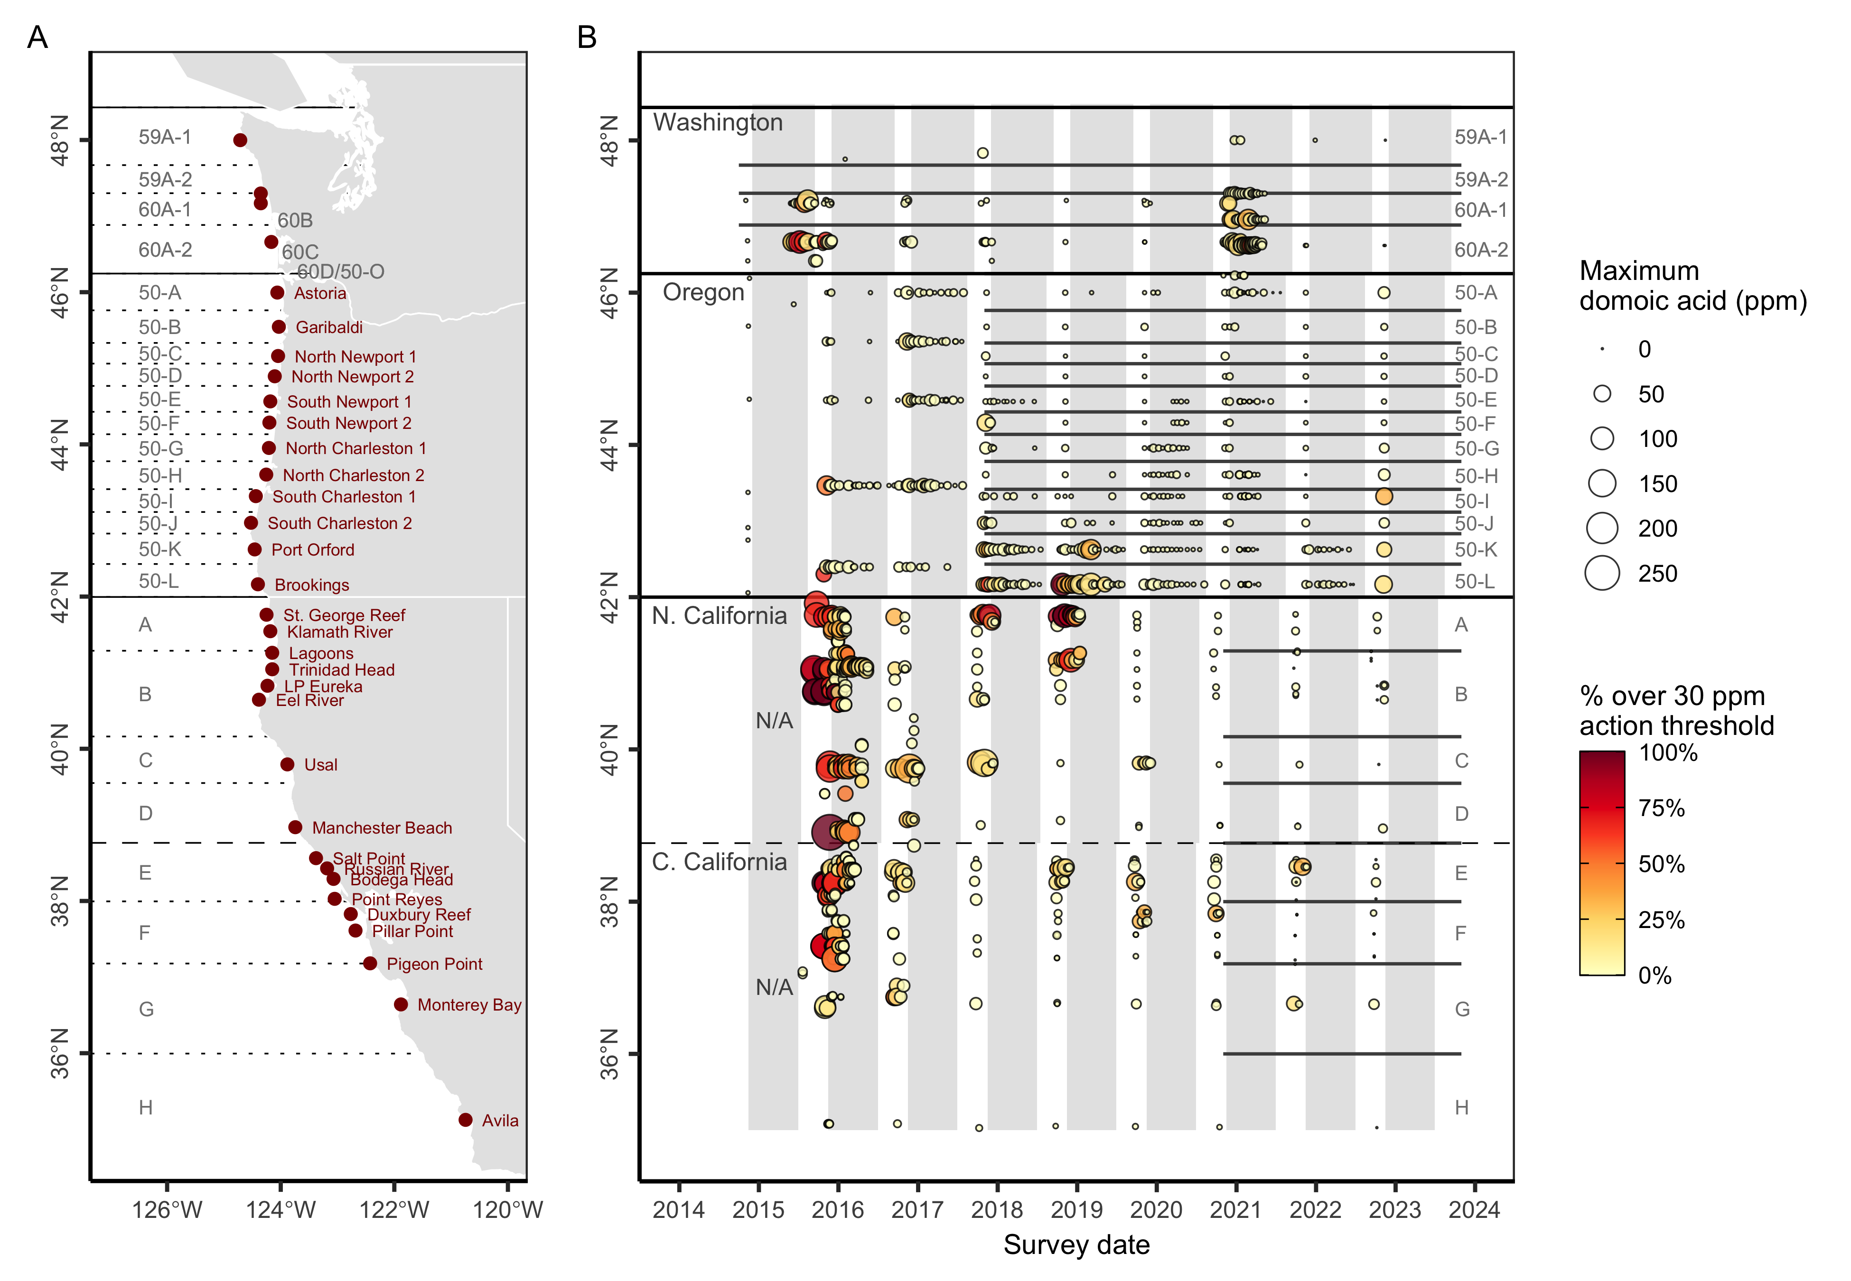

Slide 5
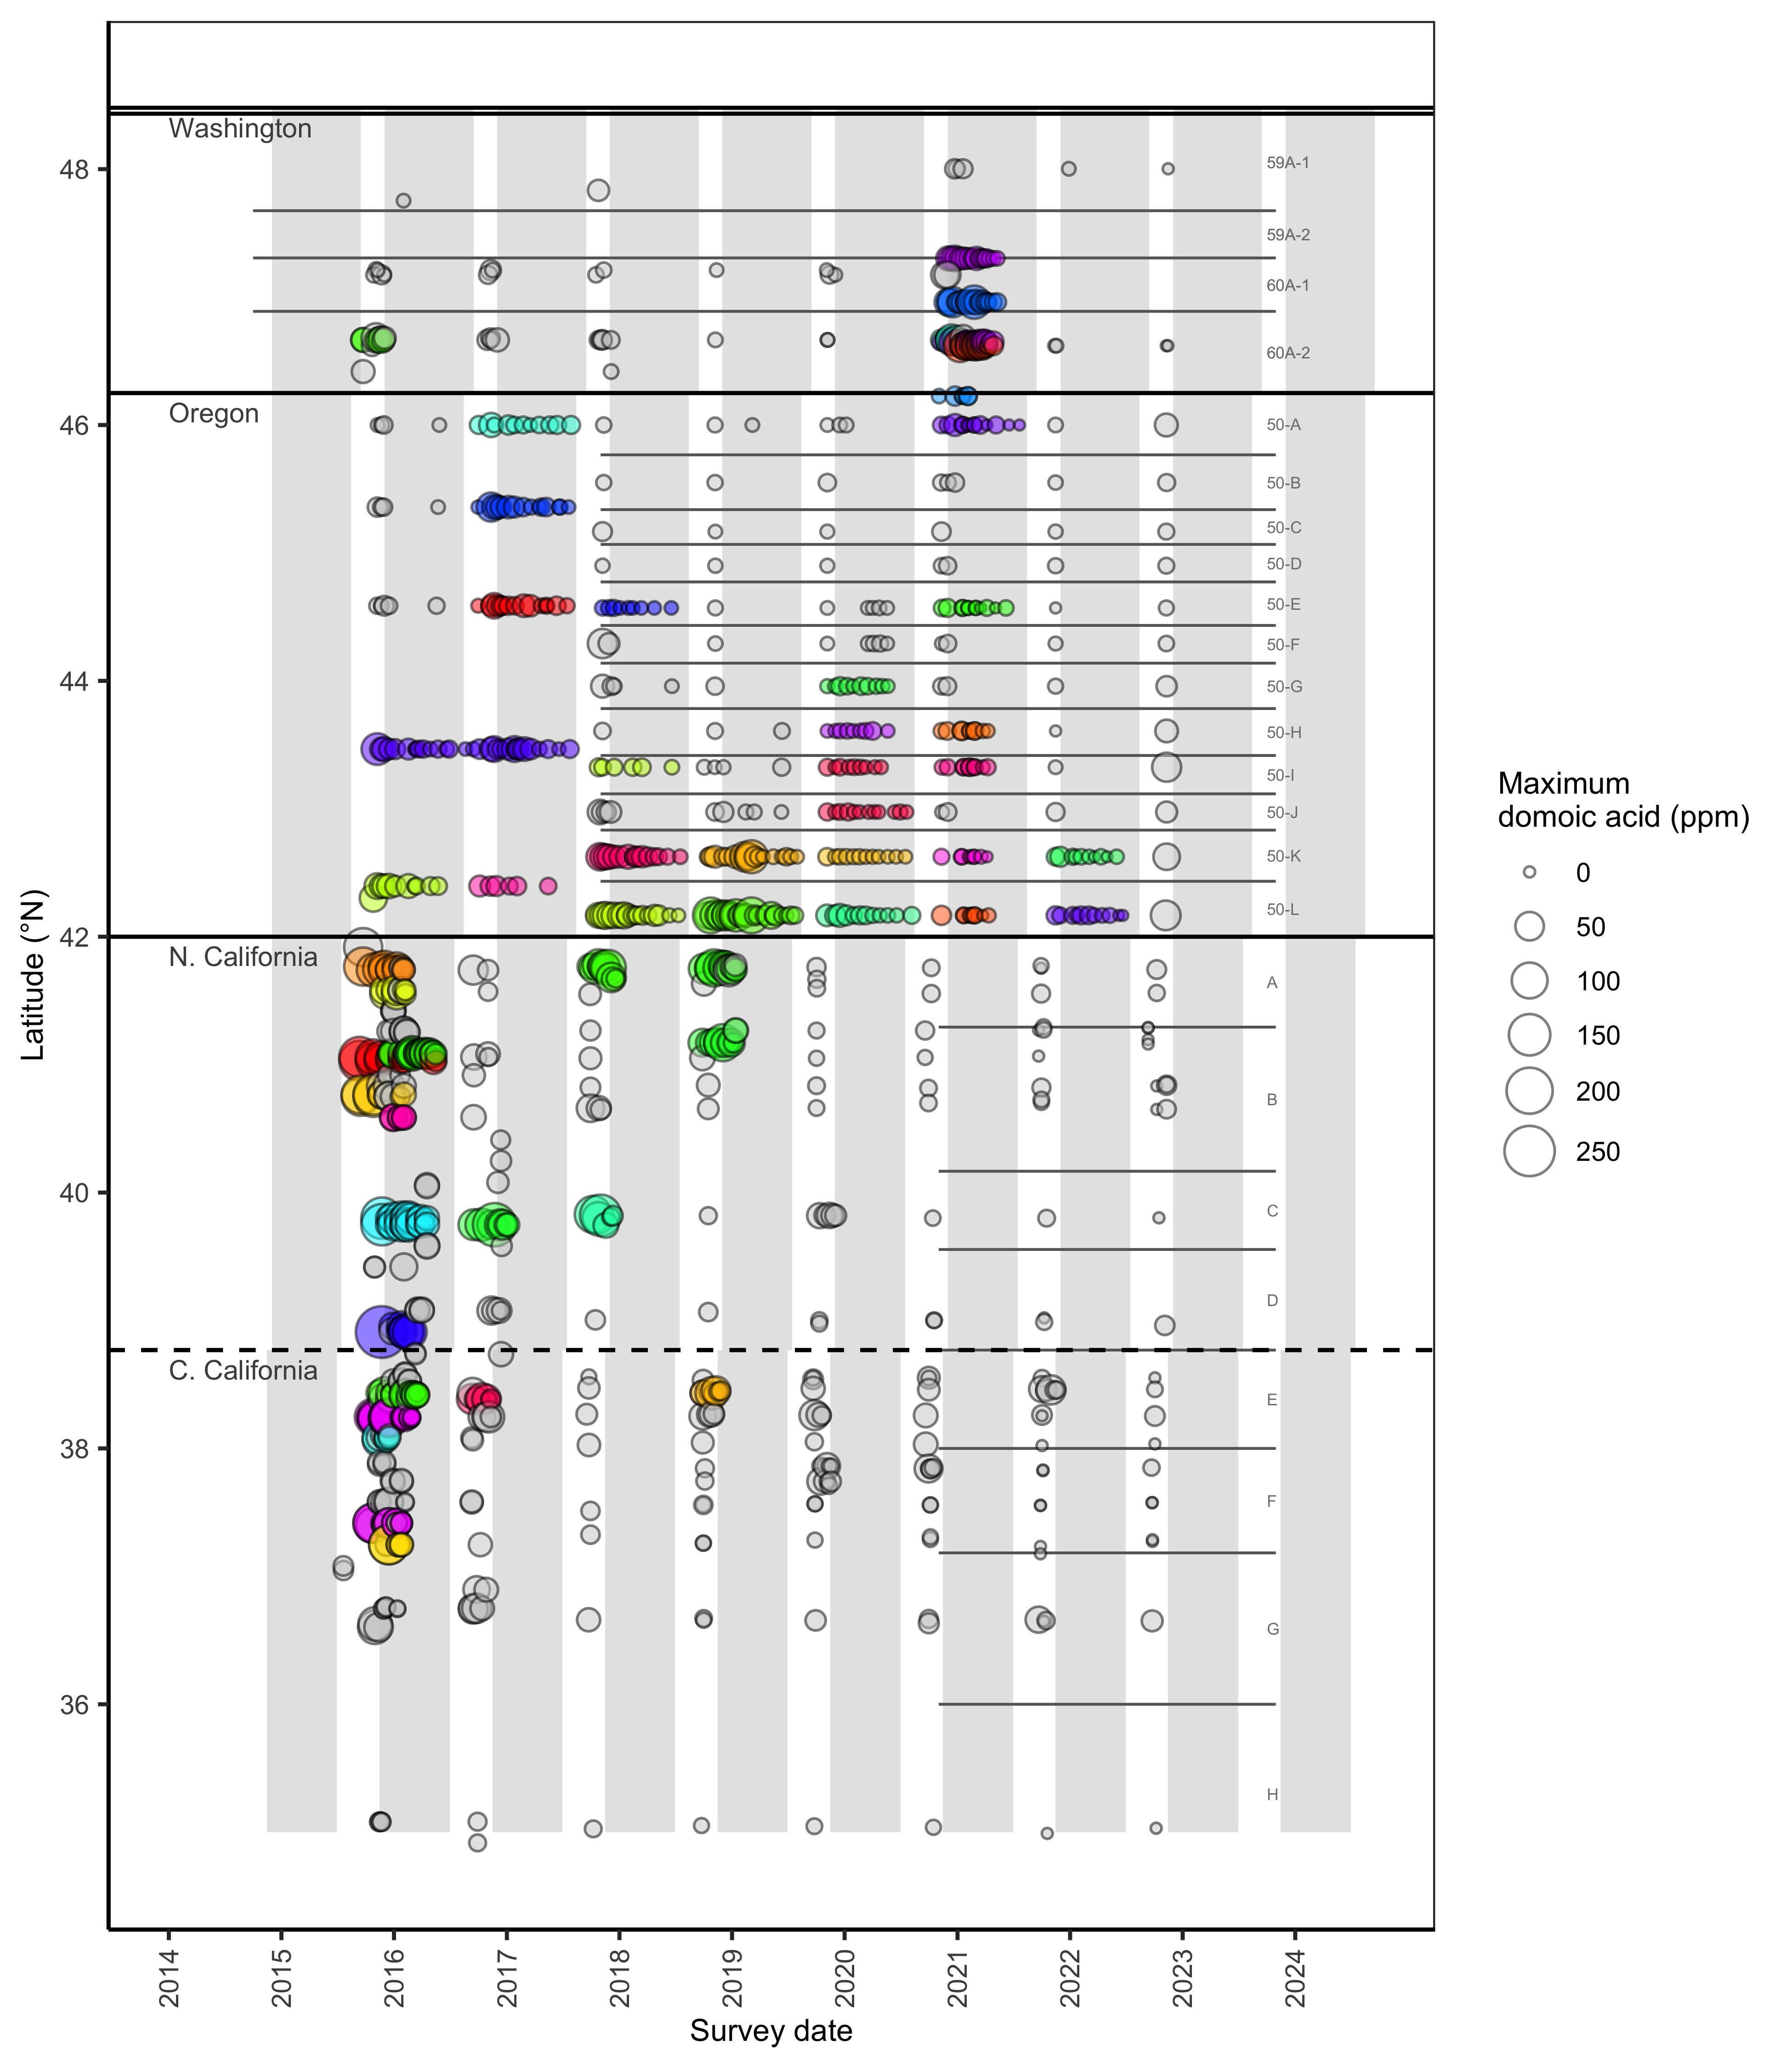
Event classification

Slide 6
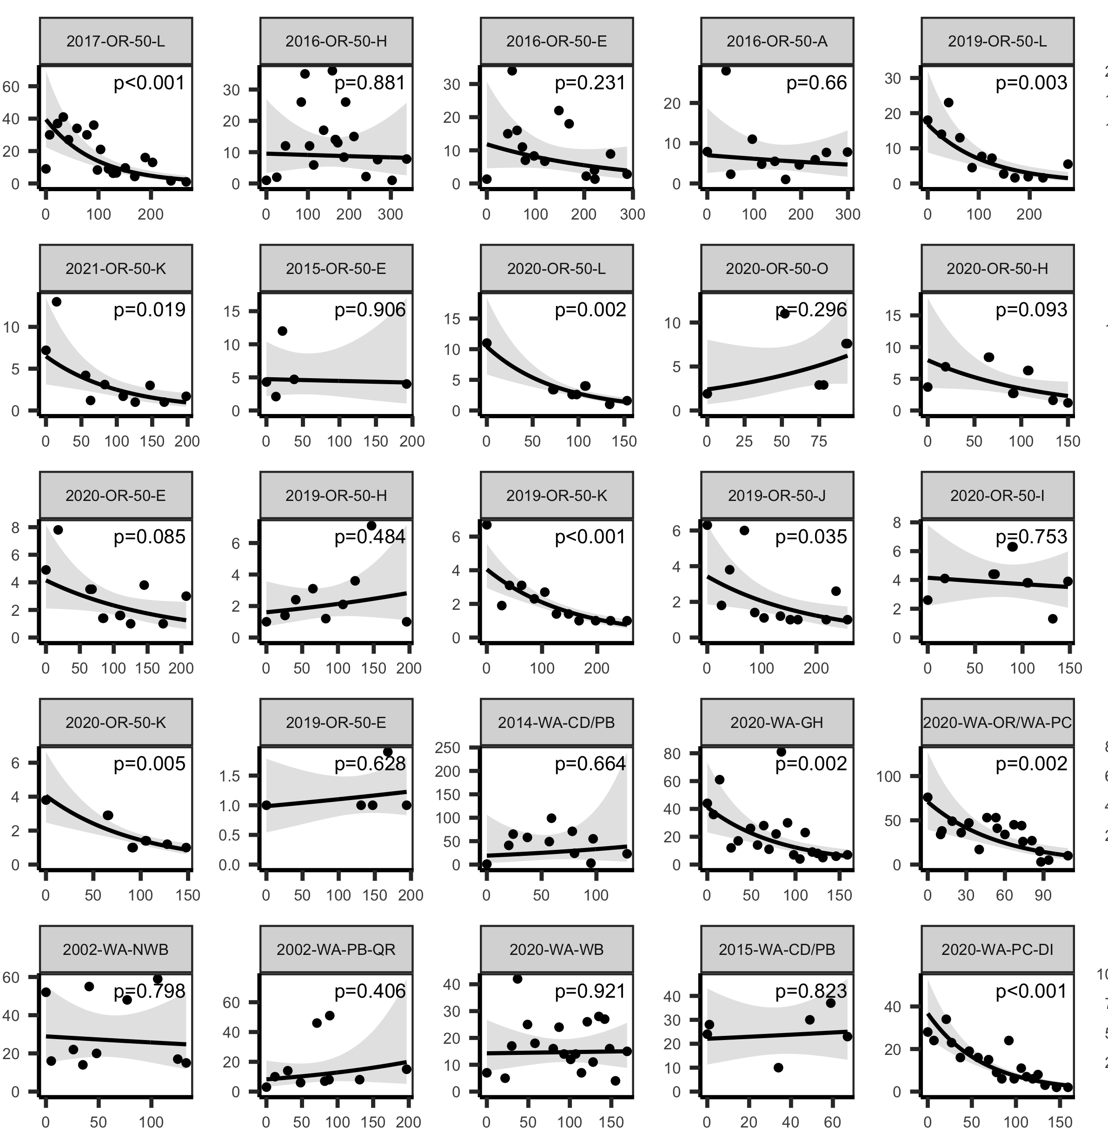
Depuration rates
Maximum domoic acid contamination
Day of event

Slide 7
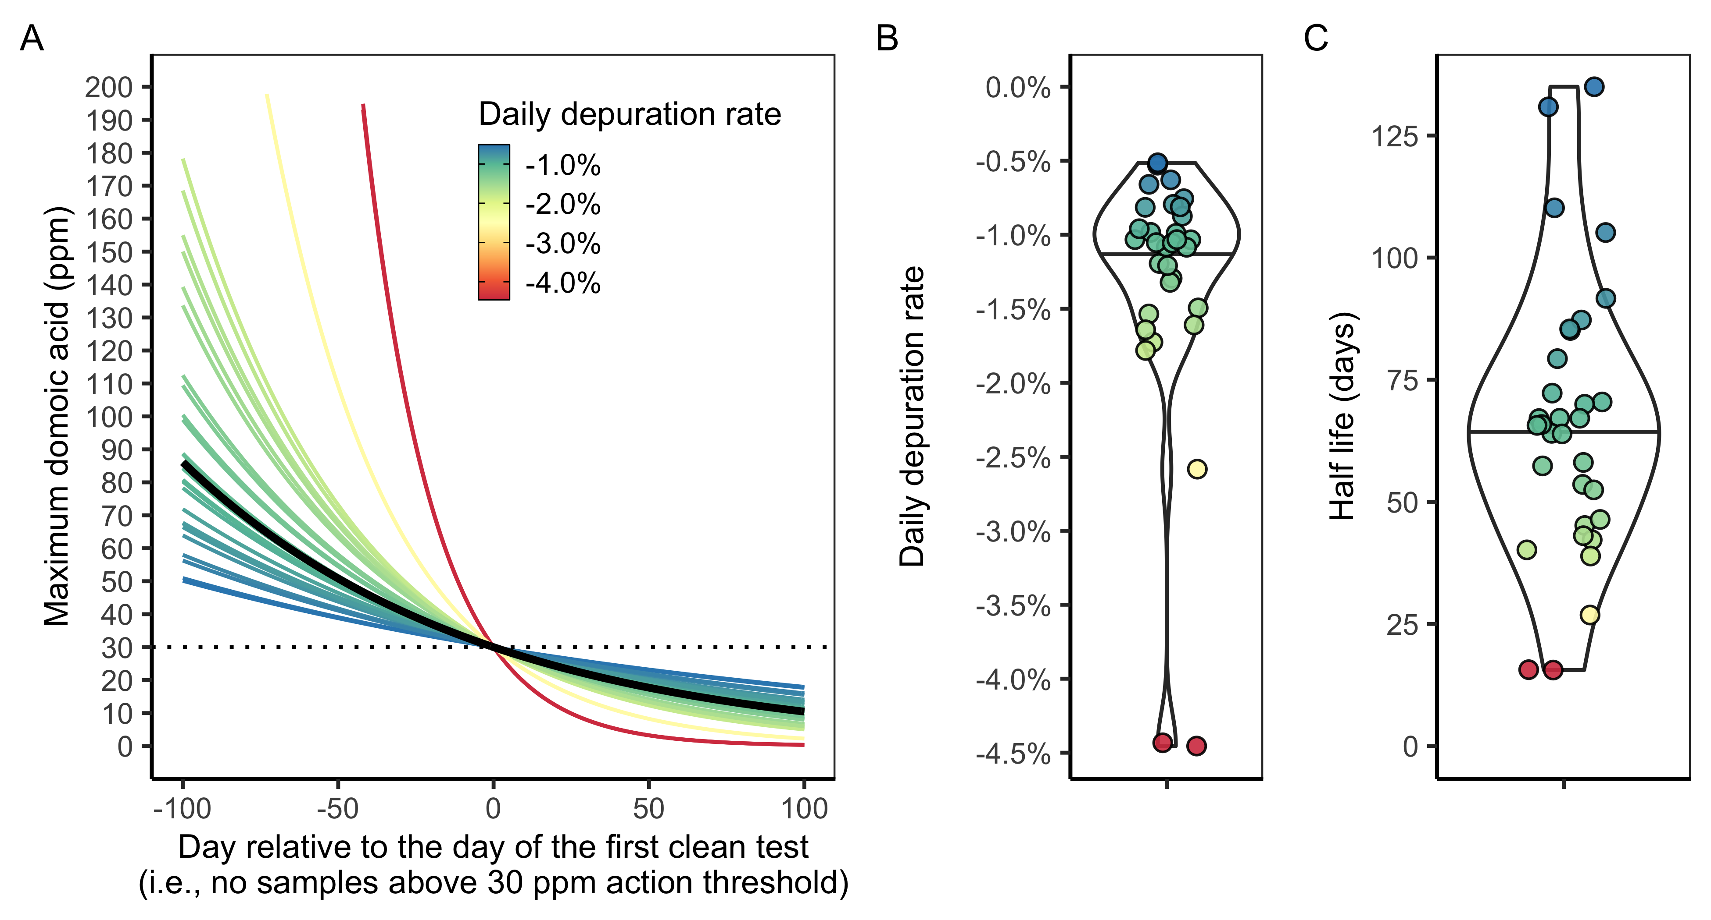
Depuration rates
Lund et al. (1997):
11.2% daily, 6.2 day half-life

Slide 8
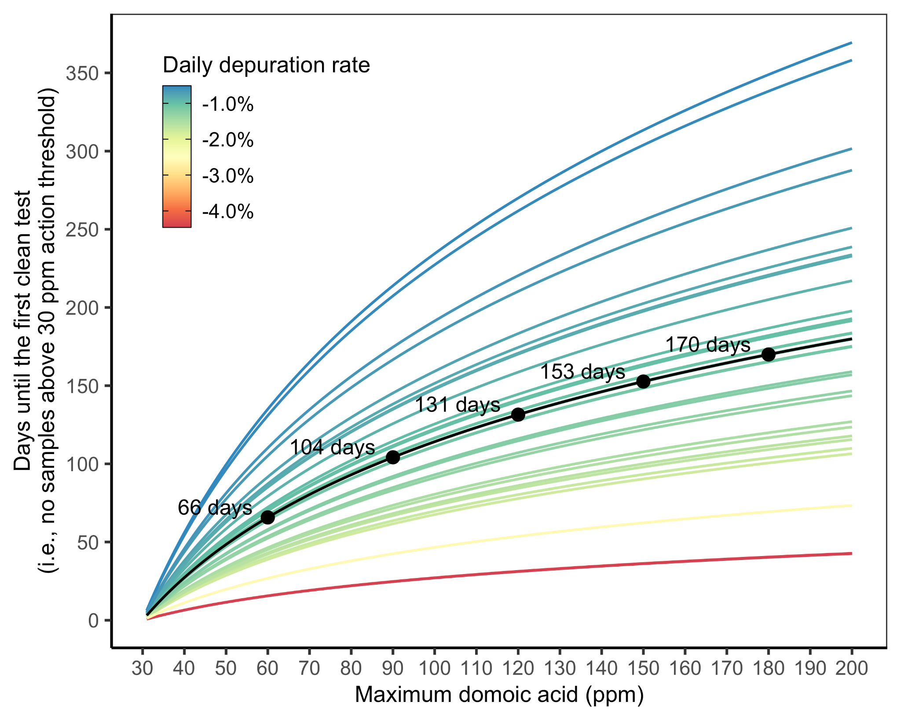
Depuration timelines

Slide 9
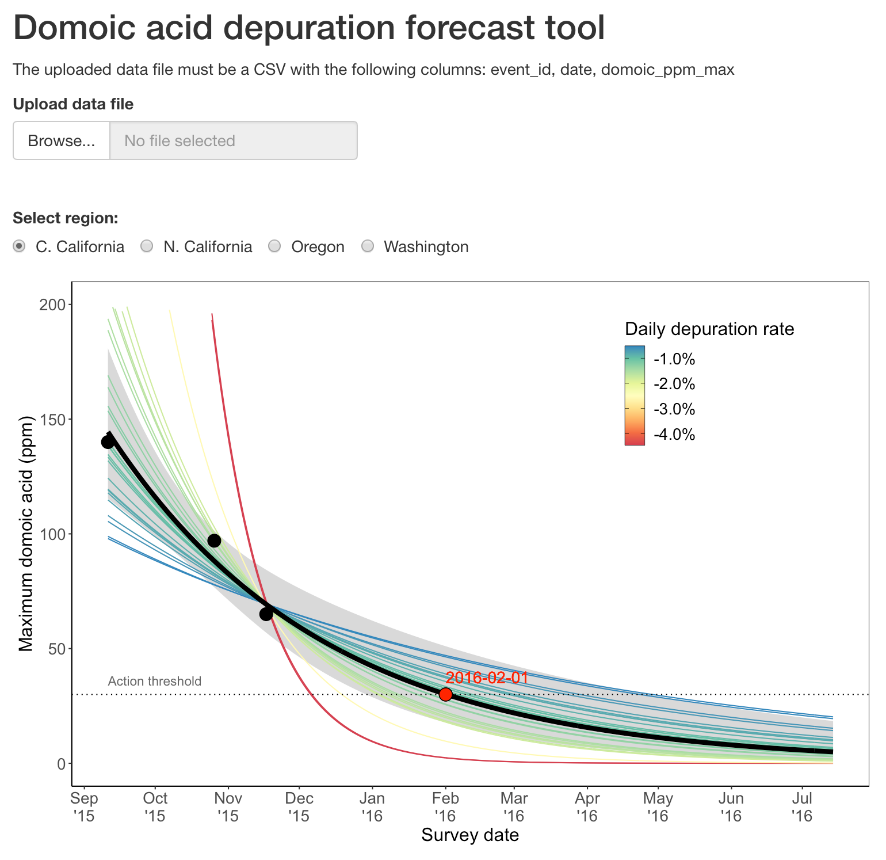
Online forecast tool

Slide 10
Next steps
More advanced modelling framework
Incorporation of environmental covariates (i.e., bottom temperature)
Development of online forecast tools

